Slide 1
Customer Segmentation Using Clustering for Business Insights
Navya Reddy
August 16, 2025

Slide 2
agenda
Introduction
Problem Statement
Objectives
Dataset Overview
Proposed Methodology
Results & Accuracy
Conclusion & Future Scope

Slide 3
INTRODUCTION
Customer Segmentation – What Does “Segmentation” Mean? Segmentation means dividing something into smaller, meaningful parts.
In customer segmentation, we divide customers into groups based on similar characteristics like age, location, spending habits, or interests.
This helps businesses understand each group better and offer products, services, or deals that match their needs.

Slide 4
PROBLEM STATEMENT
Businesses collect huge amounts of customer data, but without proper analysis, this data remains unused.
Different customers have different needs, spending habits, and preferences.
If all customers are treated the same, marketing efforts become less effective, leading to wasted resources and missed opportunities.
We need a way to group similar customers so that businesses can target them more accurately.

Slide 5
OBJECTIVES
To group customers into meaningful segments based on their characteristics.
To use clustering techniques (K-Means) for automatic grouping without prior labels.
To help businesses design targeted marketing strategies for each segment.
To improve customer satisfaction and increase sales efficiency.

Slide 6
Dataset Overview
Column Name | Description | Example Value
CustomerID | Unique ID for each customer | 101
Gender | Customer’s gender | Male / Female
Age | Customer’s age | 32
Annual Income (k$) | Yearly income in thousand dollars | 50
Spending Score (1–100) | Score assigned based on customer spending habits | 78

Slide 7
Proposed Methodology
Data Collection – Gather customer data from the given dataset containing attributes like Gender, Age, Annual Income, and Spending Score.
Data Preprocessing – Clean the dataset by handling missing values and ensuring correct data types.
Exploratory Data Analysis (EDA) – Analyze patterns, trends, and relationships between variables.
Clustering using K-Means – Apply the K-Means algorithm to group customers into meaningful segments.
Evaluation & Visualization – Use scatter plots and charts to visualize clusters for better interpretation.
Insights & Recommendations – Interpret cluster characteristics and provide actionable business strategies.

Slide 8
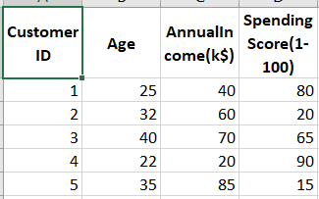
Results & Accuracy
Let’s understand the calculation using a dataset of 5 customers. We segment them into 2 clusters — one for High Spending customers and one for Low Spending customers.
High spending customers are denoted by
Low Spending customers are denoted by
We will be using python libraries pandas, matplotlib and sklearn.

Slide 9
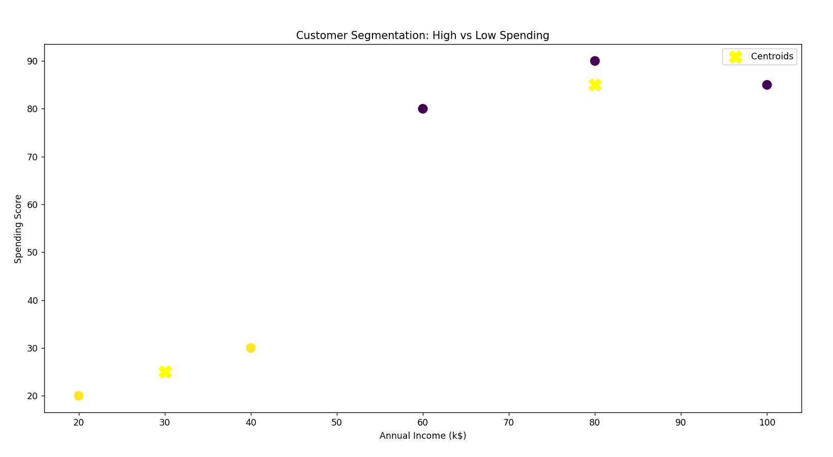
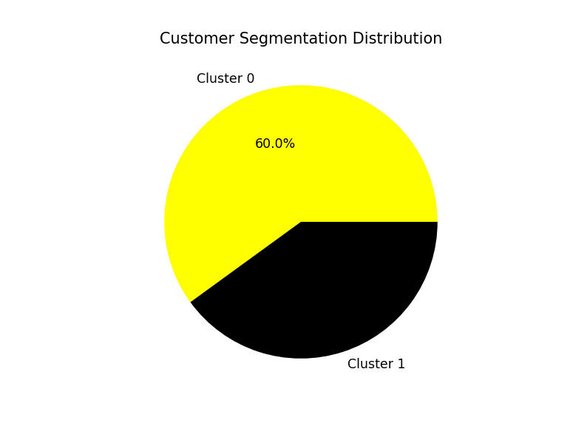
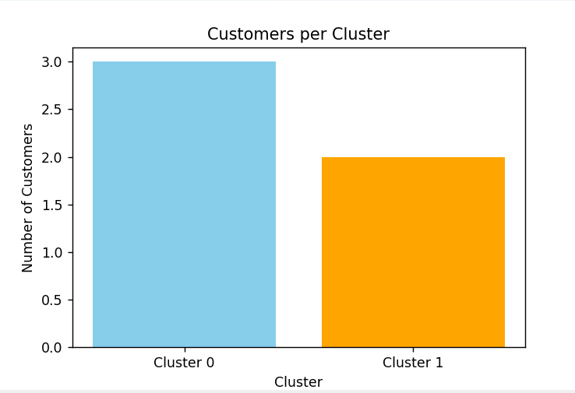
Centroids are the average spending of customers in each cluster, representing its center point.

Slide 10
Thank you

